Slide 1
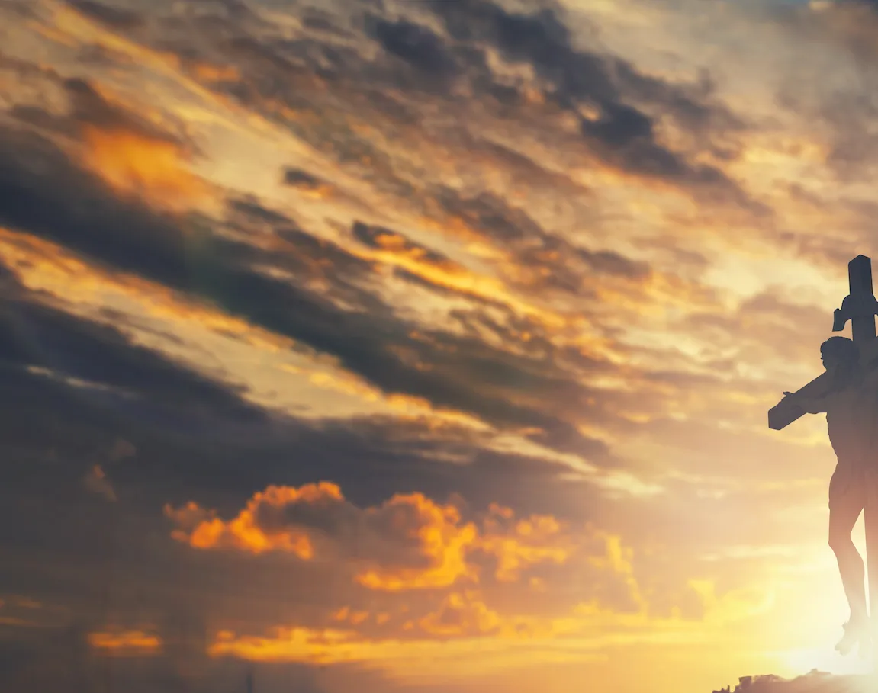
Living Hope

Slide 2
G C / G C CAPO 4th
G D
How great the chasm that lay between us
C Em D
How high the mountain I could not climb
G D
In desperation, I turned to heaven
C D G
And spoke Your name into the night

Slide 3
C
Then through the darkness,
G
Your loving kindness
Em D
Tore through the shadows of my soul
G D
The work is ﬁnished, the end is written
C D G C
Jesus Christ, my living hope

Slide 4
G D
Who could imagine so great a mercy?
C Em D
What heart could fathom such boundless grace?
G D
The God of ages stepped down from glory
C D G
To wear my sin and bear my shame

Slide 5
C G
The cross has spoken, I am forgiven
Em D
The King of kings calls me His own
G D
Beautiful Savior, I'm Yours forever
C D G
Jesus Christ, my living hope

Slide 6
C G D Em
Hallelujah, praise the One who set me free
C G D Em
Hallelujah, death has lost its grip on me
C G
You have broken every chain
D Em D
There's salvation in Your name
C D G
Jesus Christ, my living hope

Slide 7
G D
Then came the morning that sealed the promise
C Em D
Your buried body began to breathe
G D
Out of the silence, the Roaring Lion
C D G (Em)
Declared the grave has no claim on me
C D G
Jesus, Yours is the victory

Slide 8
C G D Em
Hallelujah, praise the One who set me free
C G D Em
Hallelujah, death has lost its grip on me
C G
You have broken every chain
D Em D
There's salvation in Your name
C D G
Jesus Christ, my living hope

Slide 9
C D Em
Jesus Christ, my living hope
C D G
Oh God, You are my living hope
END

Slide 10
America the Beautiful

Slide 11
CAPO 2nd
G D
O beautiful for spacious skies,
D7 G
for amber waves of grain
D
For purple mountain majesties,
A A7 D D7
above the fruited plain!

Slide 12
G D
America! America!
D7 G
God shed his grace on thee
C G
And crown thy good with brotherhood,
C D7 G
from sea to shining sea!

Slide 13
G D
O beautiful for pilgrim feet,
D7 G
whose stern impassioned stress
D
A thoroughfare of freedom beat,
A A7 D D7
across the wilderness!

Slide 14
G D
America! America!
D7 G
God mend thine every flaw
C G
Confirm thy soul in self-control,
C D7 G
Thy liberty in law!

Slide 15
G D
O beautiful for patriot dream,
D7 G
that sees beyond the years
D
Thine alabaster cities gleam,
A A7 D D7
undimmed by human tears!

Slide 16
G D
America! America!
D7 G
God shed his grace on thee
C G
And crown thy good with brotherhood,
C D7 G
from sea to shining sea!
END

Slide 17
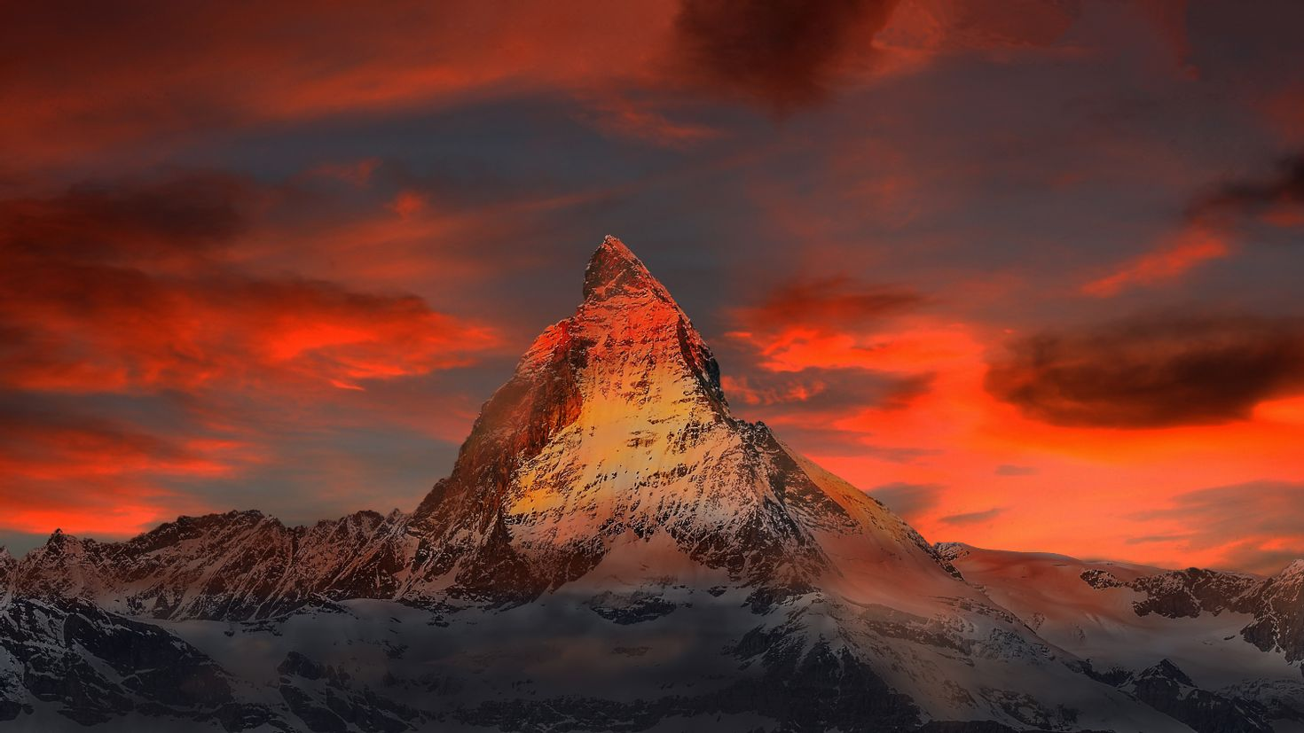
I Exalt Thee

Slide 18
D A G A D A
I exalt Thee, I exalt Thee, I exalt Thee, O Lord
D A G A D A
I exalt Thee, I exalt Thee, I exalt Thee, O Lord
1 of 2

Slide 19
D A G A D A
I exalt Thee, I exalt Thee, I exalt Thee, O Lord
D A G A D
I exalt Thee, I exalt Thee, I exalt Thee, O Lord
2 of 2

Slide 20
D Em A D Bm
For Thou, O Lord, art high above all the earth
Em A D
Thou art exalted far above all gods
D Em A D Bm
For Thou, O Lord, art high above all the earth
Em A D
Thou art exalted far above all gods

Slide 21
D A G A D A
I exalt Thee, I exalt Thee, I exalt Thee, O Lord
D A G A D A
I exalt Thee, I exalt Thee, I exalt Thee, O Lord
1 of 2

Slide 22
D A G A D A
I exalt Thee, I exalt Thee, I exalt Thee, O Lord
D A G A D
I exalt Thee, I exalt Thee, I exalt Thee, O Lord
2 of 2 & END

Slide 23
Build My Life

Slide 24
G C / G C
G C
Worthy of every song we could ever sing
G C
Worthy of all the praise we could ever bring
G C
Worthy of every breath we could ever breathe
G
We live for You
C
We live for You

Slide 25
G C
Jesus the name above every other name
G C
Jesus the only one that could ever save
G C
Worthy of every breath we could ever breathe
G
We live for You
C
We live for You

Slide 26
C Am G
Holy there is no one like You There is none beside You
Em C
Open up my eyes in wonder and Show me who You are
Am
And fill me with Your heart
G
And lead me in Your love
Em C
to those around me

Slide 27
G C
Jesus the name above every other name
G C
Jesus the only one that could ever save
G C
Worthy of every breath we could ever breathe
G
We live for You
C
Oh We live for You

Slide 28
C Am G
Holy there is no one like You There is none beside You
Em C
Open up my eyes in wonder and Show me who You are
Am
And fill me with Your heart
G
And lead me in Your love
Em C
to those around me

Slide 29
C D Em
I will build my life, upon Your love
G
It is a firm foundation
C D Em
I will put my trust, in You alone
G
And I will not be shaken
play twice & to chorus

Slide 30
C Am G
Holy there is no one like You There is none beside You
Em C
Open up my eyes in wonder and Show me who You are
Am
And fill me with Your heart
G
And lead me in Your love
Em C
to those around me
END

Slide 31
I Stand Amazed in the Presence

Slide 32
G
I stand amazed in the presence
D G
Of Jesus the Nazarene
C G
And wonder how He could love me,
G D G
A sinner, condemned, unclean

Slide 33
G
How marvelous, How wonderful
D
And my song shall ever be:
G Em
How marvelous, How wonderful
Am G D G
Is my Savior's love for me

Slide 34
G
He took my sins and my sorrows;
D G
He made them His very own
C G
He bore the burden to Calvary,
G D G
And suffered and died alone

Slide 35
G
How marvelous, How wonderful
D
And my song shall ever be:
G Em
How marvelous, How wonderful
Am G D G
Is my Savior's love for me

Slide 36
G
When with the ransomed in glory,
D G
His face I at last shall see
C G
’Twill be my joy through the ages
G D G
To sing of His love for me

Slide 37
G
How marvelous, How wonderful
D
And my song shall ever be:
G Em
How marvelous, How wonderful
Am G D G
Is my Savior's love for me
END

